Slide 1



BVI Services Management
Organization Tools for the VI Professional
June 6, 2023
1-4 pm
ESC 17 Rogers Rm

Slide 2






How does a VI Professional organize services when there is no end in sight?
That’s the question we will address today!

Slide 3
AGENDA – BVI Services Organization
Student At-A-Glance
Vision Plan for Student with CVI
Instructional Planning
101 Handouts
Digital Uploading
Evaluation Templates
Annual Registration

Slide 4
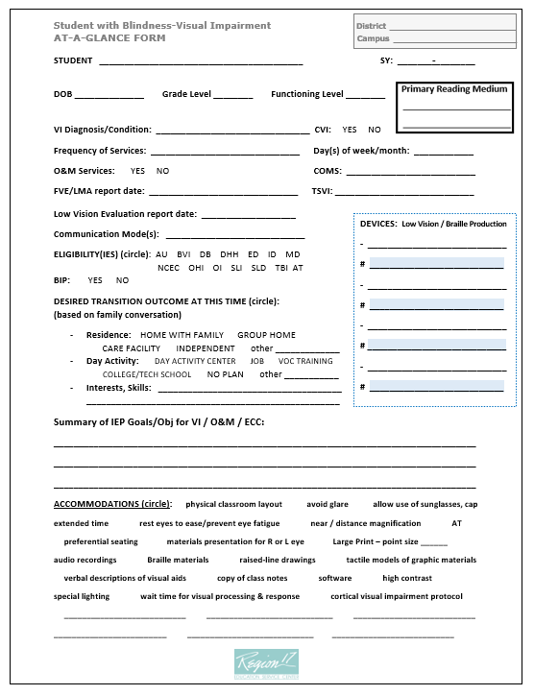
Benefits of at-a-glance form
Place in grab-n-go student folder for meetings
Ease of review as needed
Device management
Goal/Obj. focus prompt
Reminders: due date, BIP, etc.

Slide 5
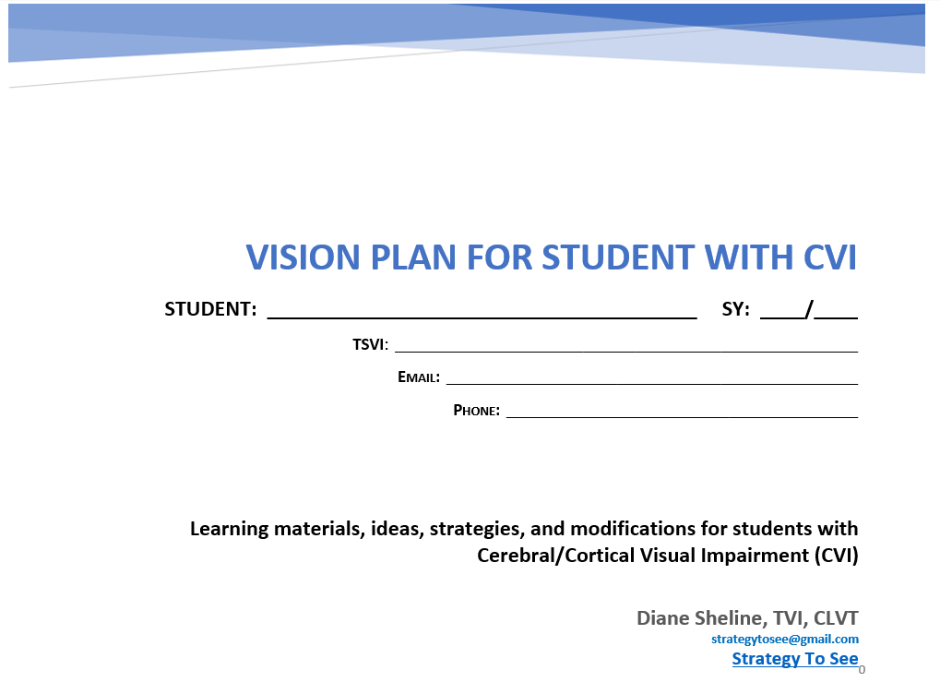
Benefits of a vision plan
Place in grab-n-go folder
Ease of review as needed
Reminder of materials, strategies, & modifications
to be used by all.
Legal benefits (noted next)

Slide 6
The legal benefits are established.
2017 US Supreme Court ruling briefing on Special Education: Endrew F.
Given the landmark Rowley case rule from years ago, many schools have argued, and courts have agreed, that all that is in fact required by schools is that the student receive merely some appreciable benefit of special education and related services. But unanimous decision by 2017 US Supreme Court reversed a lower court’s usage of the “some benefit” formula, sends a very powerful message throughout our entire sped system that says just doing something for students with disabilities is not nearly enough!
(paraphrased from AFB.ORG)

Slide 7

What do we learn from this 2017 Endrew F. case?
Focus on the particular child is at the core of the IDEA.
We are, therefore, directed to offer “specially designed” instruction to meet the child’s “unique needs”.
The child’s unique needs are met through an “individualized education program” (IEP).
The essential function of an IEP is to set out a plan for pursuing the child’s academic and functional advancement.
Academic and functional advancement should be appropriate in light of the child’s circumstances.

Slide 8

How is this accomplished for a student with CVI?
Vision Plan for Student with CVI

Slide 9
RESOURCES
BENEFITS OF INSTRUCTIONAL PLANNING
  TEKS Resource System
  Grade Level & Functional Level Graphic (next slide)
  TEKS Vertical Alignment Documents & Framework
  Birth to Grade 2 Vertical Alignments
  Active Learning

